Slide 1
Chavda harshil
ALA:1
Subject: CN
Enrollment:241105060018
Topic: Ring Topology

Slide 2
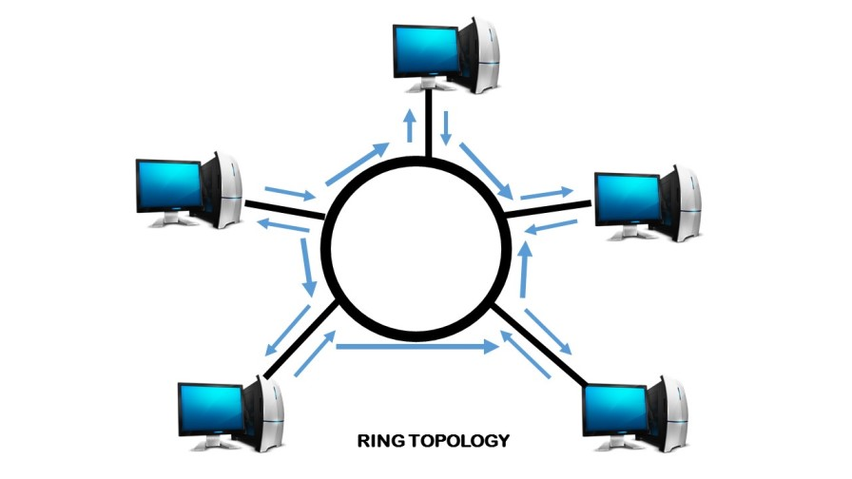
Ring Topology Diagram

Slide 3
Ring topology
Definition
Ring Topology is a type of computer network arrangement in which all devices such as computers, printers, and other network components are connected in a closed circular loop. In this topology, each device is directly connected to exactly two neighboring devices, one on each side, creating a continuous ring structure without the use of a central hub or controller.
In this network arrangement, data transmission follows a fixed and orderly path. When a device sends data, the information travels from one device to the next around the ring. Each device receives the data signal, checks whether the data is intended for it, and if not, forwards it to the next connected device. This process continues until the data reaches its correct destination.

Slide 4
Key Point
1. Circular Network Structure
2. Two Neighboring Connections per Device
3. No Central Controlling Device
4. Sequential Data Transmission
5. Data Checking and Forwarding
6. Low Chance of Data Collision
7. Equal Access to Network Resources
8. Effect of Failure in the Network

Slide 5
Advantages
1. No Data Collision
2. Equal Access for All Devices
3. Organized and Predictable Data Flow
4. Good Performance Under Heavy Load
5. Easy to Identify Network Faults
6. No Need for Central Hub
7. Efficient Use of Network Resources

Slide 6
Disadvantages
1. Failure of One Device Affects the Entire Network
2. Difficult to Add or Remove Devices
3. Slower Data Transmission Compared to Star Topology
4. Complex Troubleshooting and Maintenance
5. Dependency on Each Device
6. Limited Scalability
7. Outdated Technology

